Slide 1
Marketing Funnels
Analyze Data with SQL
Luis Virgen
5/17/2023

Slide 2
Table of Contents
Context
Survey Funnel
A/B Test Query
Marketing Funnel Analysis

Slide 3
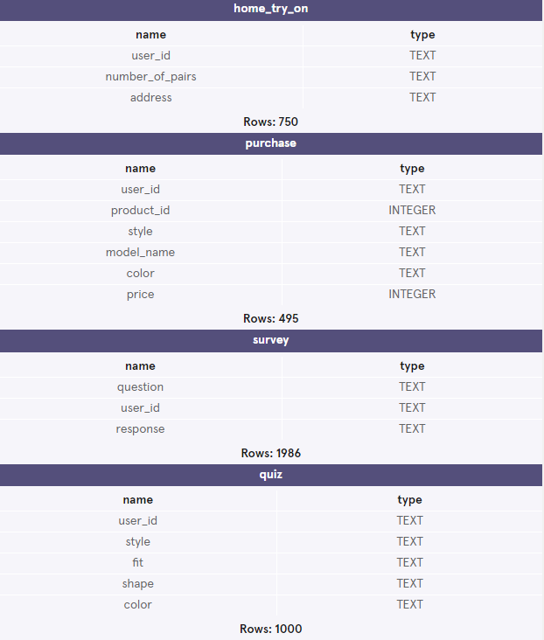

CONTEXT
Warby Parker is a transformative lifestyle brand with a lofty objective: to offer designer eyewear at a revolutionary price while leading the way for socially conscious businesses

Slide 4
Survey Funnel

Slide 5
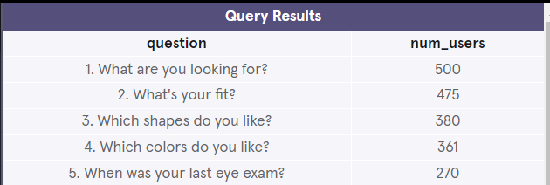
Survey Funnel
Users will “give up” at different points in the survey. Let’s analyze how many users move from Question 1 to Question 2, etc.
SELECT question,
COUNT(DISTINCT user_id) as 'num_users'
FROM survey
GROUP BY question
LIMIT 10;

Slide 6
A/B Test Query

Slide 7
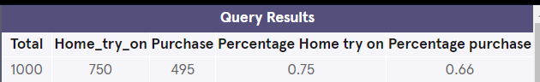
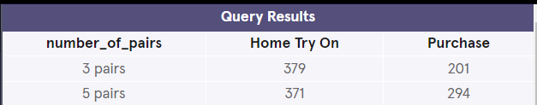
Home Try-On Funnel
Warby Parker’s purchase funnel is:
Take the Style Quiz → Home Try-On → Purchase the Perfect Pair of Glasses
During the Home Try-On stage, we will be conducting an A/B Test:
50% of the users will get 3 pairs to try on
50% of the users will get 5 pairs to try on
Let’s find out whether or not users who get more pairs to try on at home will be more likely to make a purchase.
--Temporary Table
WITH funnel AS (
SELECT DISTINCT q.user_id,
h.user_id is not null as 'is_home_try_on',
h.number_of_pairs,
p.user_id is not null as 'is_purchase'
FROM quiz as 'q'
LEFT JOIN home_try_on as 'h'
ON q.user_id=h.user_id
LEFT JOIN purchase as 'p'
ON h.user_id=p.user_id
)
--Users that go through each stage
SELECT COUNT(*) as 'Total',
SUM(is_home_try_on) as 'Home_try_on',
SUM(is_purchase) as 'Purchase',
1.0*SUM(is_home_try_on) / COUNT(user_id) as 'Percentage Home try on',
1.0*SUM(is_purchase) / SUM(is_home_try_on) as 'Percentage purchase'
FROM funnel;
--A(B Test Query
SELECT number_of_pairs,
SUM(is_home_try_on) as 'Home Try On',
SUM(is_purchase) as 'Purchase'
FROM funnel
WHERE number_of_pairs is not null
GROUP BY number_of_pairs
LIMIT 10;

